Slide 1
Chapter 5:
Physical Database Design and Performance
Modern Database Management
10th Edition
Jeffrey A. Hoffer, V. Ramesh,
Heikki Topi
© 2011 Pearson Education, Inc. Publishing as Prentice Hall

Slide 2
Physical Database Design
Purpose–translate the logical description of data into the technical specifications for storing and retrieving data
Goal–create a design for storing data that will provide adequate performance and insure database integrity, security, and recoverability
Notes:
Purpose is to achieve optimal performance . In the age of big data, and terabytes, petabyte db, it is important to have an optimal physical database design

Slide 3
Physical Design Process
Inputs
Decisions
Normalized relations
Volume estimates
Attribute definitions
Response time expectations
Data security needs
Backup/recovery needs
Integrity expectations
DBMS technology used
Attribute data types
Physical record descriptions (doesn’t always match logical design)
File organizations
Indexes and database architectures
Query optimization
Leads to
Notes:
At the point where you need to design a physical db:
Normalized relations -> if it is a relational system, 3NF
Volume estimates: GB, PB etc
Attribute definitions
Response time expectations: Business requirements
Data security needs: Are there regulations you need to keep in mind. Security data such as CC, SS#, which encryption algorithm
Backup/recovery needs: daily, incremental etc
Integrity expectations
DBMS technology used: Oracle, DB2, Postgress, MySQL, SQL Server
Decision during database physical DB design :
Attribute data types --- what type of data types. ASCII, Unicode ( international customers… Primary key int 32 bit vs 64 bit
Physical record descriptions ()
File organizations : for large dbs it is important
Indexes and database : used for optimal reads
Query optimization: how do you optimize your query to run fast

Slide 4
Choosing Data Types
CHAR–fixed-length character
VARCHAR2–variable-length character (memo)
LONG–large number
NUMBER–positive/negative number
INEGER–positive/negative whole number
DATE–actual date
BLOB–binary large object (good for graphics, sound clips, etc.)

Slide 5
SQL Server Data Types
Numeric:
  Int, bigint, decimal, money, smallint, bit
Date and Time
  Date, datetime, time, samlldatetime
Character string
  Char, varchar
Unicode
  Nchar, nvarchar

Slide 6
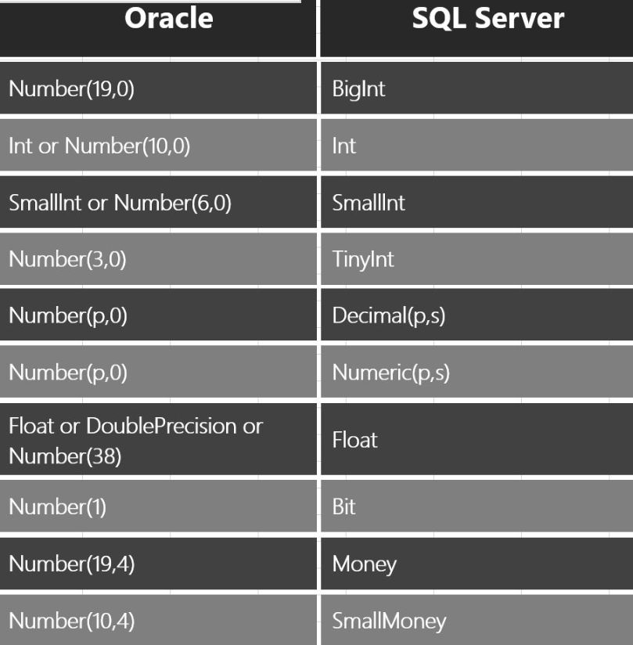
SQL Server/Oracle Data Types
https://blog.sqlauthority.com/2016/06/14/sql-server-oracle-numeric-datatype-mapping/

Slide 7
Denormalization
Transforming normalized relations into non-normalized physical record specifications
Benefits:
  Can improve performance (speed) by reducing number of table lookups (i.e. reduce number of necessary join queries)
Costs (due to data duplication)
  Wasted storage space
  Data integrity/consistency threats
Common denormalization opportunities
  One-to-one relationship (Fig. 5-3)
  Many-to-many relationship with non-key attributes (associative entity) (Fig. 5-4)
  Reference data (1:N relationship where 1-side has data not used in any other relationship) (Fig. 5-5)
Notes:
It is the opposite of Normalization. Typically, not done in transactional system. This is done only in decision support systems such as data warehouses.

Slide 8
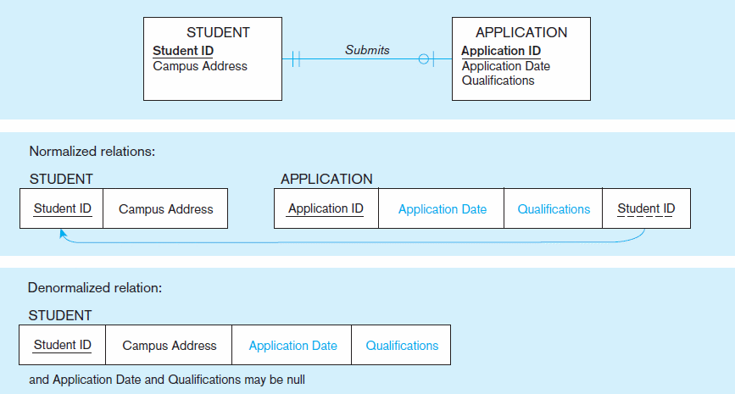
Figure 5-3 A possible denormalization situation: two entities with one-to-one relationship

Slide 9
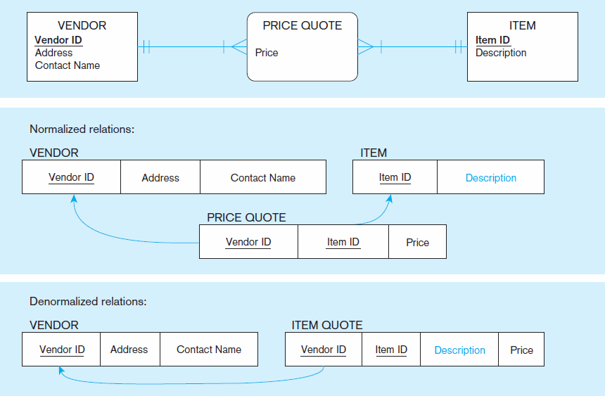
Figure 5-4 A possible denormalization situation: a many-to-many relationship with nonkey attributes
Extra table access required
Null description possible

Slide 10
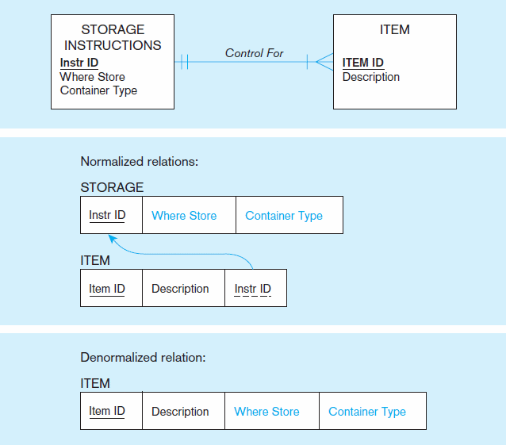
Figure 5-5
A possible denormalization situation:
reference data
Extra table access required
Data duplication

Slide 11
Partitioning (cont.)
Advantages of Partitioning:
  Efficiency: Records used together are grouped together
  Local optimization: Each partition can be optimized for performance
  Security: data not relevant to users are segregated
  Recovery and uptime: smaller files take less time to back up
  Load balancing: Partitions stored on different disks, reduces contention
Disadvantages of Partitioning:
  Inconsistent access speed: Slow retrievals across partitions
  Complexity: Non-transparent partitioning
  Extra space or update time: Duplicate data; access from multiple partitions

Slide 12
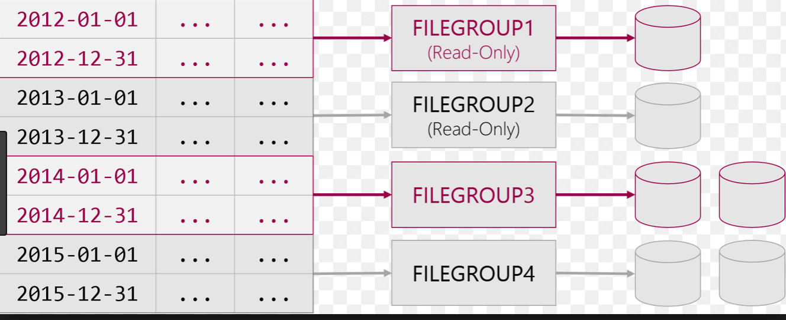
Example of Horizontal Partitioning (range)
https://www.cathrinewilhelmsen.net/2015/04/12/table-partitioning-in-sql-server/

Slide 13
Designing Physical Files
Physical File:
  A named portion of secondary memory allocated for the purpose of storing physical records
  Tablespace–named set of disk storage elements in which physical files for database tables can be stored
  Extent–contiguous section of disk space
Constructs to link two pieces of data:
  Sequential storage
  Pointers–field of data that can be used to locate related fields or records

Slide 14
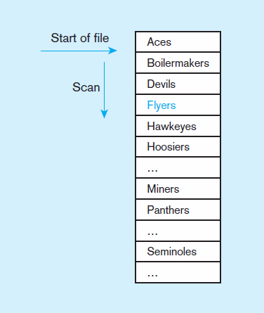
Figure 5-7a Sequential file organization
1
2
Records of the file are stored in sequence by the primary key field values
If sorted – every insert or delete requires resort
If not sorted
Average time to find desired record = n/2
n

Slide 15
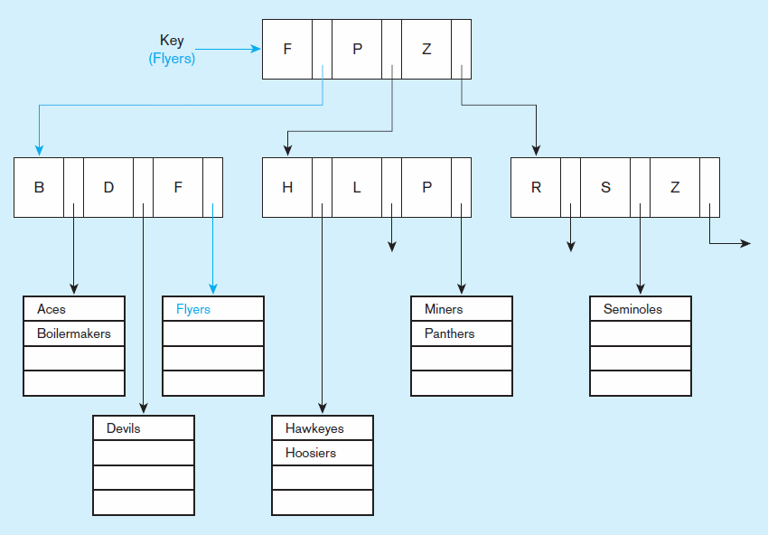
Figure 5-7b Indexed file organization
uses a tree search
Average time to find desired record = depth of the tree
Notes:
Indexed algorithm uses tree search!
You never have to do this, the database does this for you automatically.

Slide 16
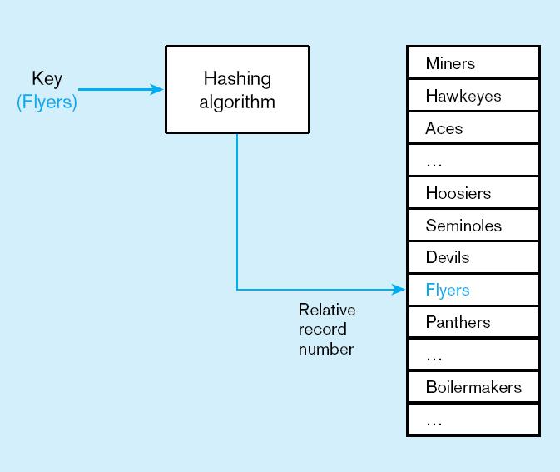
Figure 5-7c
Hashed file organization
Hash algorithm
Usually uses division-remainder to determine record position. Records with same position are grouped in lists.
Notes:
It uses certain hash algorithm to determine where the record is located. Typically division remainder.

Slide 17
Rules for Using Indexes
Use on larger tables
Index the primary key of each table
Index search fields (fields frequently in WHERE clause)
Fields in SQL ORDER BY and GROUP BY commands
When there are >100 values but not when there are <30 values

Slide 18
Rules for Using Indexes (cont.)
Avoid use of indexes for fields with long values; perhaps compress values first
If key to index is used to determine location of record, use surrogate (like sequence nbr) to allow even spread in storage area
DBMS may have limit on number of indexes per table and number of bytes per indexed field(s)
Be careful of indexing attributes with null values; many DBMSs will not recognize null values in an index search

Slide 19
Query Optimization
Parallel query processing–possible when working in multiprocessor systems
Overriding automatic query optimization–allows for query writers to preempt the automated optimization
Picking data block size–factors to consider include:
  Block contention, random and sequential row access speed, row size
Balancing I/O across disk controllers
Notes:
Data block size matters.
In DW 32K where bigger blocks of data are read. In OLTP, you may want smaller block size
Balance I/O across many LUN (Logical unit number) Number of drives available for the SATA. You may want your index in the fastest drive. SSD.

